Slide 1

MOBILE PRICE CLASSIFICATION
PREDICTIVE II By: AKINTUNDE AKINWALE

Slide 2

Explore the main software and hardware components that determine mobile phones prices in the market.
What is the relationship between the battery capacity and talk time?
✓ What are the important features to consider before buying a new mobile phone?
Research Questions

Slide 3

Methodology
This study will use the multinomial classification model which is a type of supervised machine learning approach.
The model performance across the 4 classes will be evaluated using the Receiver Operating Characteristics (ROC) metrics. In this case, a single ROC curve that shows a true positive rate versus false positive rate is not possible. Hence, I will be using the rates for each class in a One-vs-Rest (OVR) comparison to create an ROC chart for each class.

Slide 4
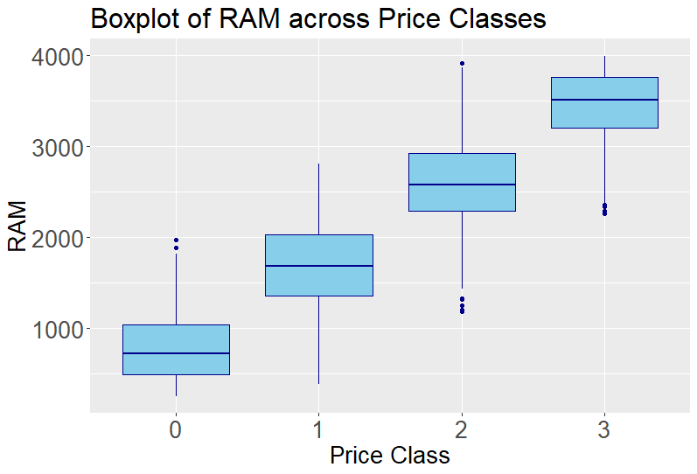

Slide 5
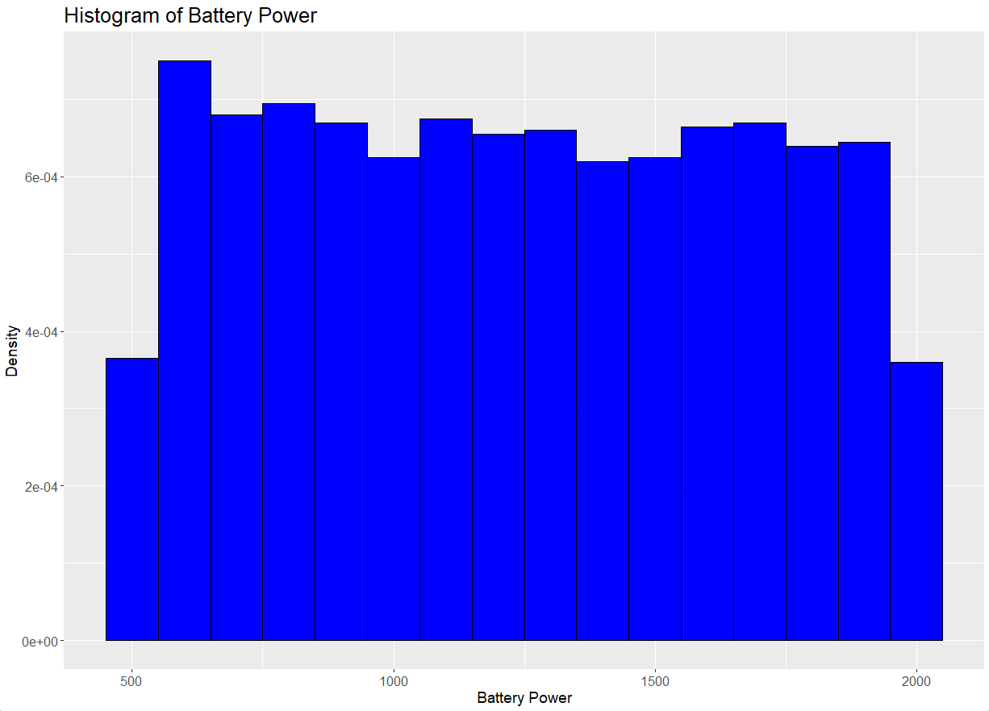
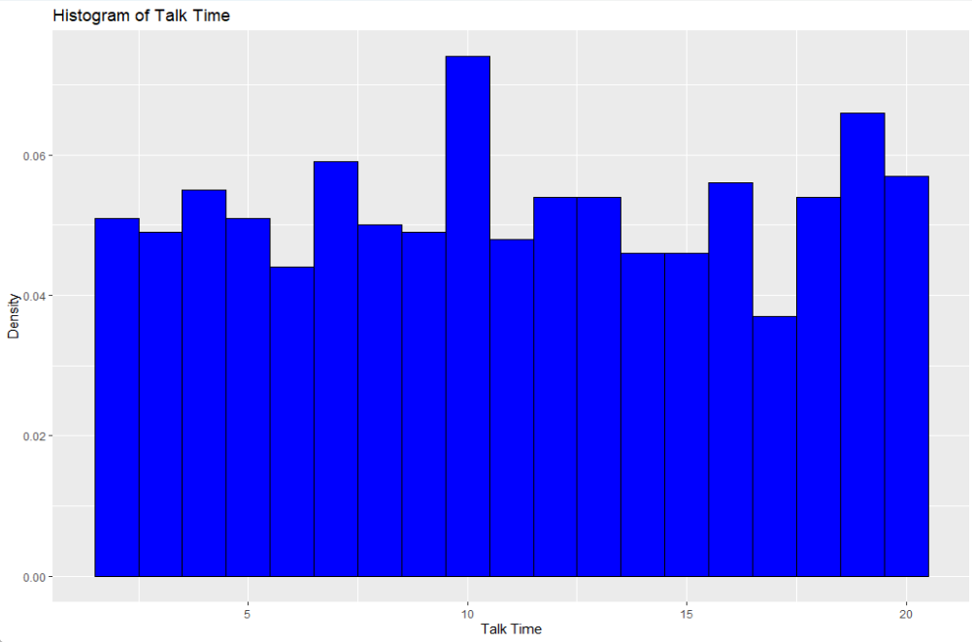

Slide 6
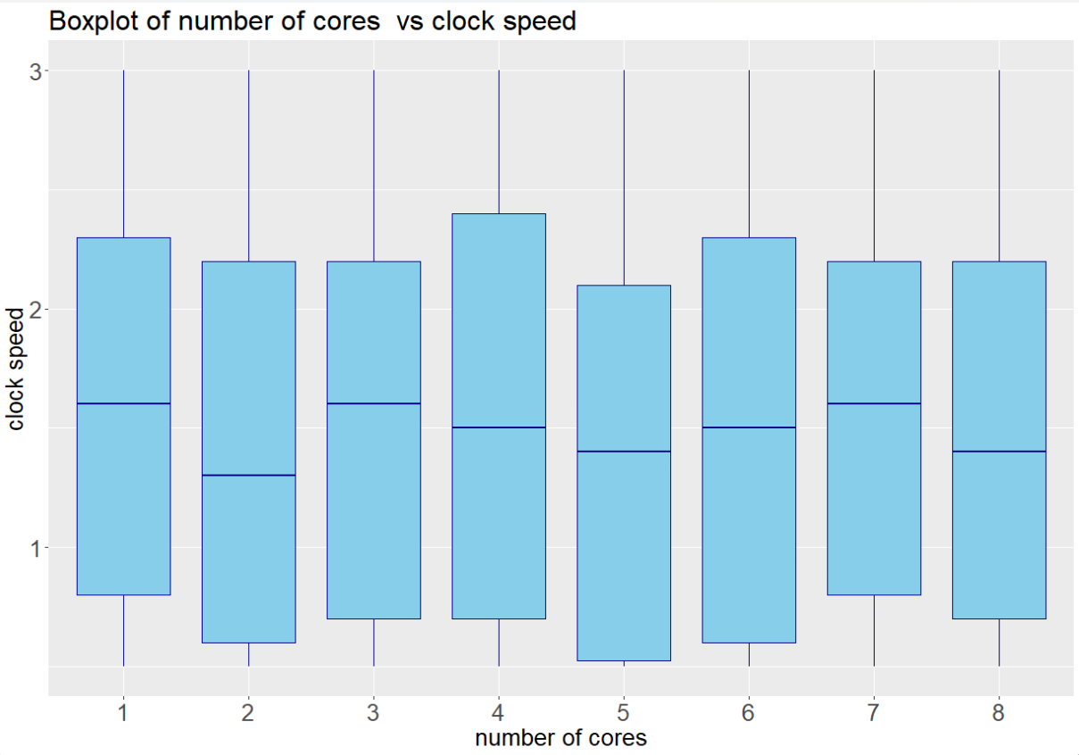
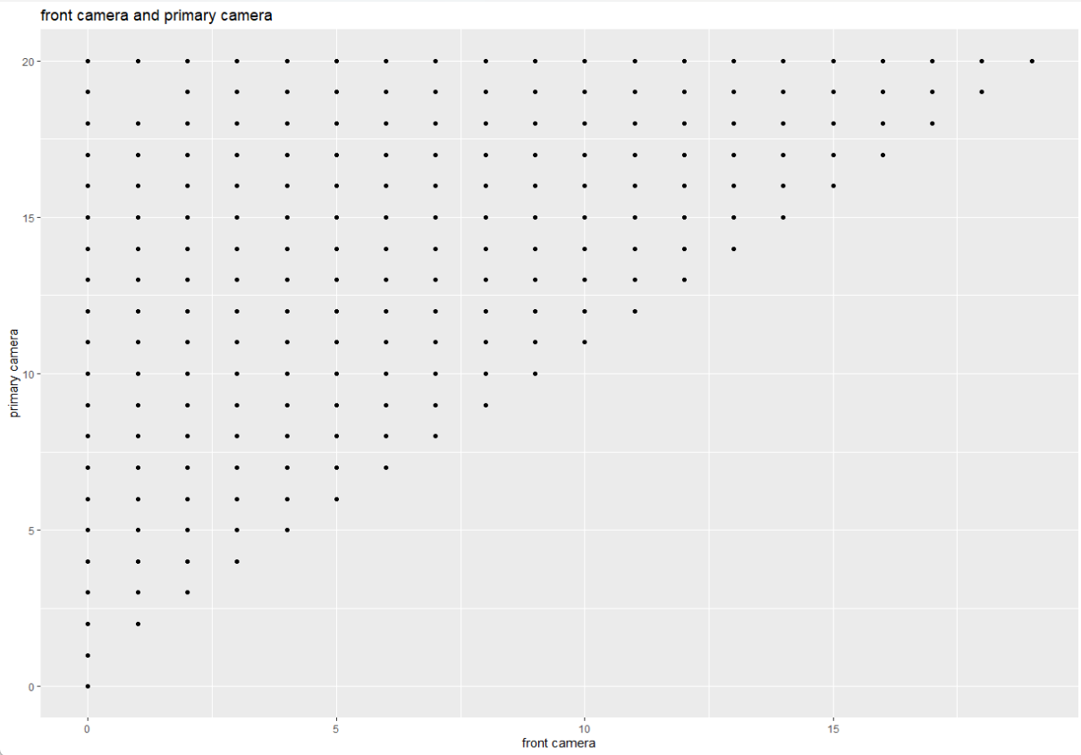

Slide 7
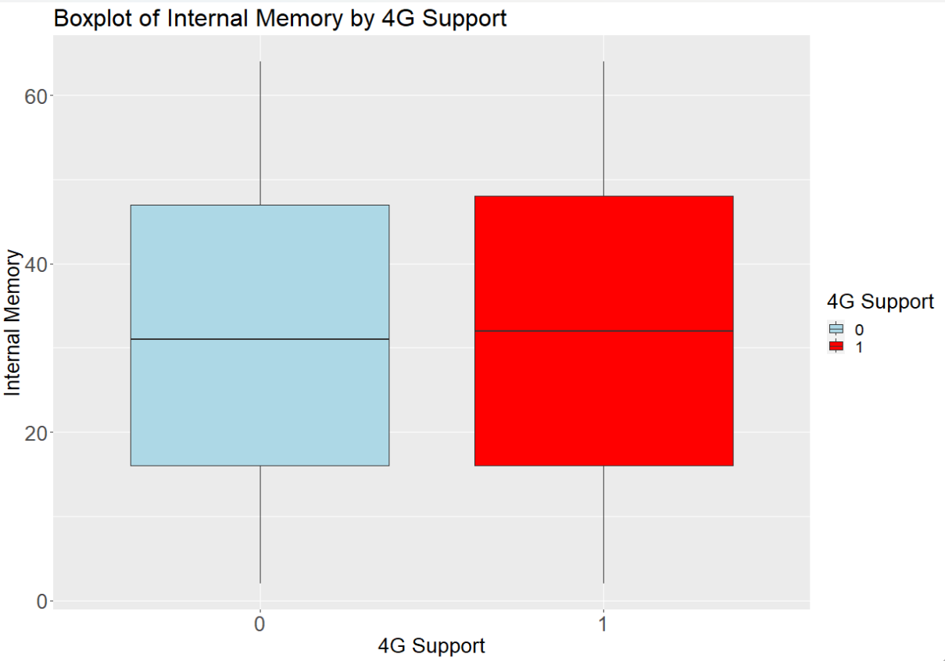
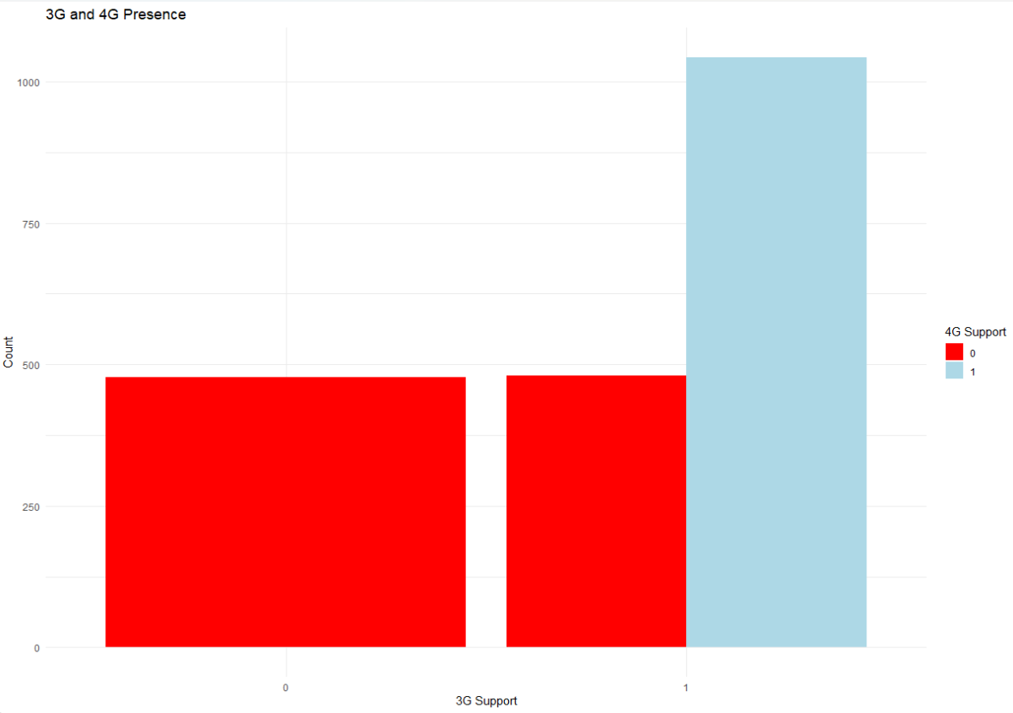

Slide 8
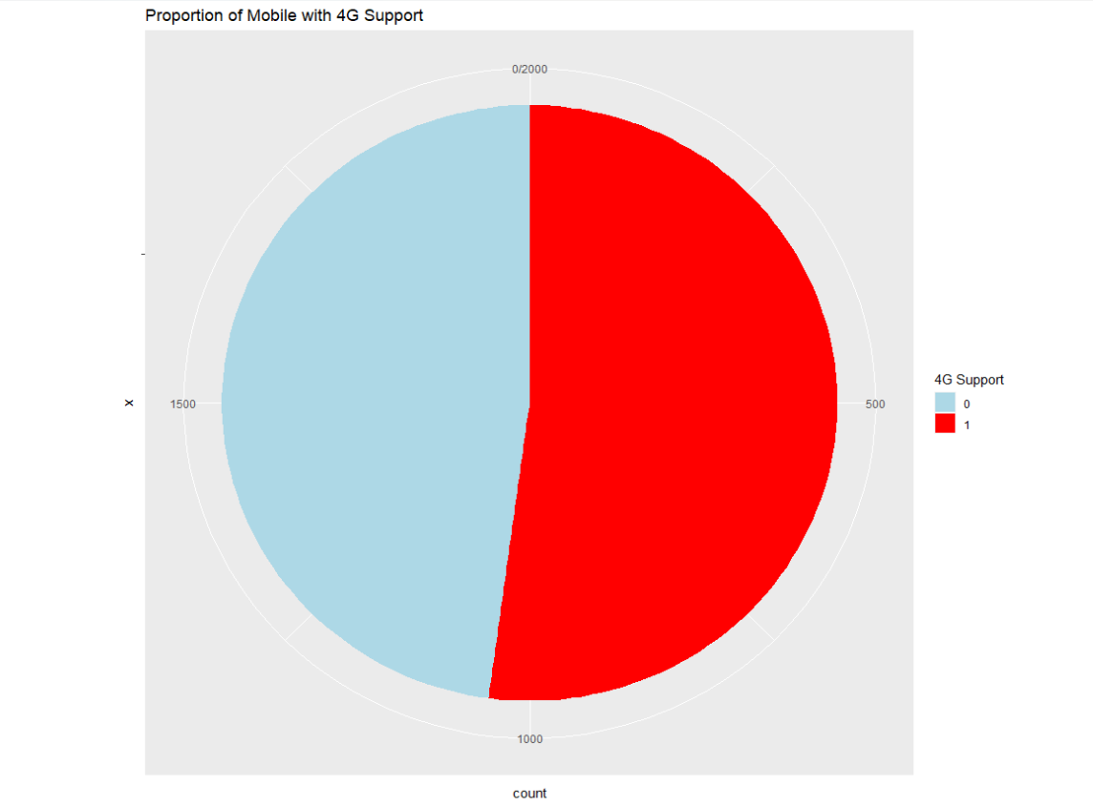
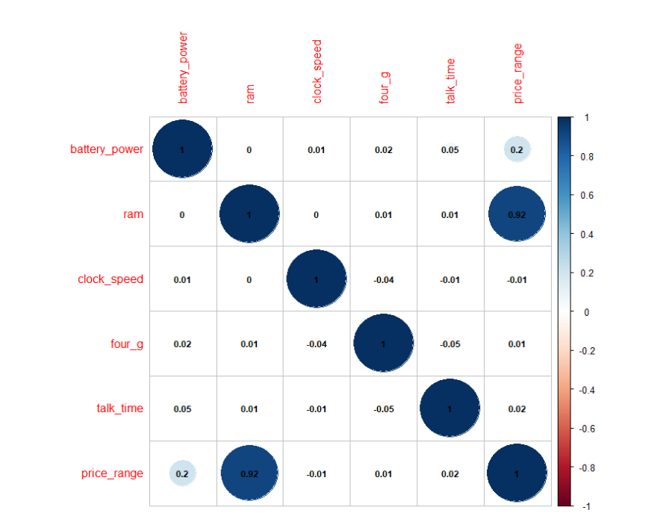

Slide 9
Coefficients: | Estimate | Std. Error | t value | Pr(>|t|)
(Intercept) | -1.68E+00 | 3.79E-02 | -44.402 | <2e-16 | ***
battery_power | 5.11E-04 | 1.64E-05 | 31.192 | <2e-16 | ***
clock_speed | -1.31E-02 | 8.82E-03 | -1.486 | 0.1375
int_memory | 9.20E-04 | 3.97E-04 | 2.318 | 0.0206 | *
px_height | 2.75E-04 | 1.89E-05 | 14.563 | <2e-16 | ***
px_width | 2.80E-04 | 1.94E-05 | 14.433 | <2e-16 | ***
ram | 9.47E-04 | 6.64E-06 | 142.617 | <2e-16 | ***
Linear Regression Model
Signif. codes: 0 ‘***’ 0.001 ‘**’ 0.01 ‘*’ 0.05 ‘.’ 0.1 ‘ ’ 1
Residual standard error: 0.3217 on 1993 degrees of freedom
Multiple R-squared: 0.9175, Adjusted R-squared: 0.9172
F-statistic: 3693 on 6 and 1993 DF, p-value: < 2.2e-16
Price_range = -1.68E+0 + 5.11E-04*battery_power - 1.31E-02*clock_speed + 9.20E-04*int_memory + 2.75E-04*px_height + 2.80E-04*px_width + 9.47E-04*ram

Slide 10
Gains Table
Depth Of File | N | Cume N | Mean Resp | Cume Mean Resp | Cume Pct of Total Resp | Lift Index | Cume Lift | Mean Model Score
27 | 164 | 164 | 3.84 | 3.84 | 41.90% | 153 | 153 | 4
52 | 147 | 311 | 2.8 | 3.35 | 69.40% | 112 | 134 | 3
77 | 149 | 460 | 1.99 | 2.91 | 89.10% | 79 | 116 | 2
100 | 140 | 600 | 1.16 | 2.5 | 100.00% | 47 | 100 | 1

Slide 11
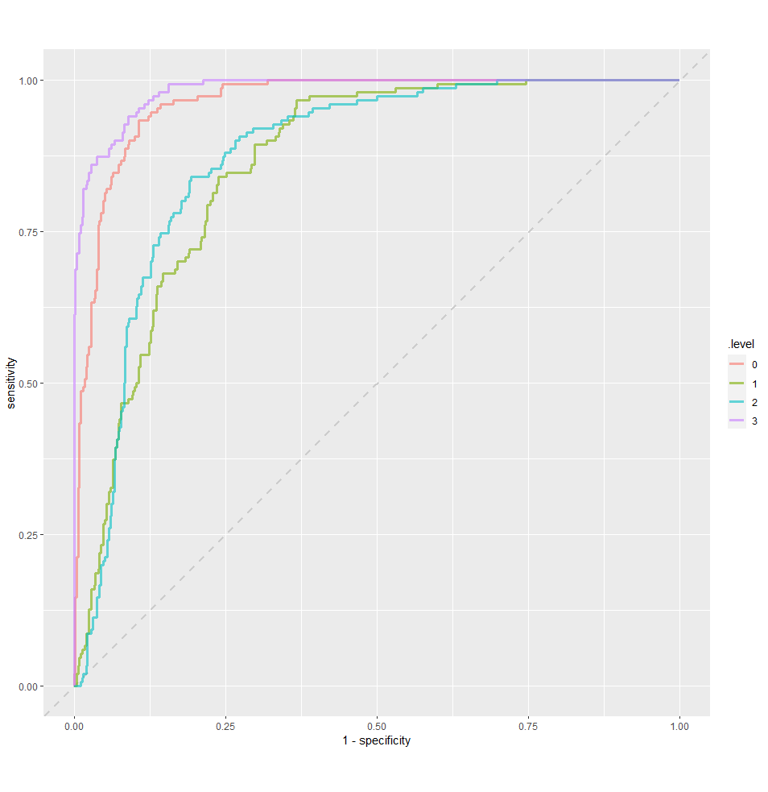
ROC

Slide 12
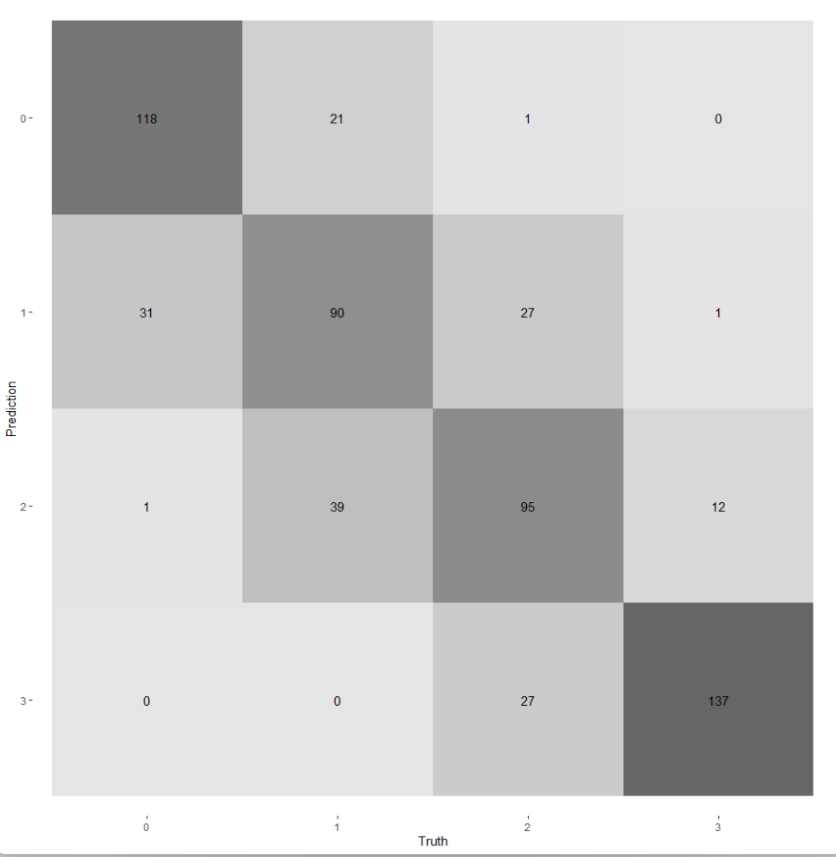
Confusion Matrix

Slide 13
Photo Collage
Thank You

